Slide 1
Hostel Management website
-By CE department
Vishwakarma Government Engineering College
(Team SGH000208)

Slide 2
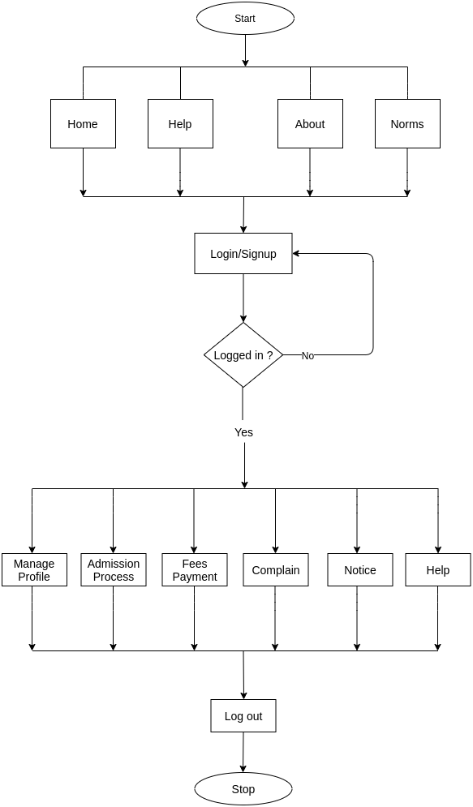
Student Flowchart

Slide 3
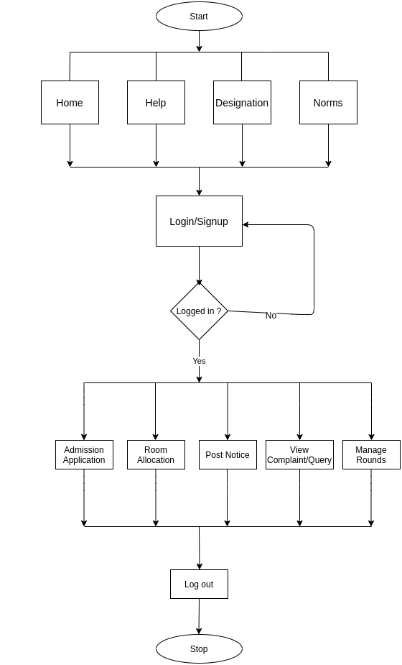
Admin Flowchart

Slide 4
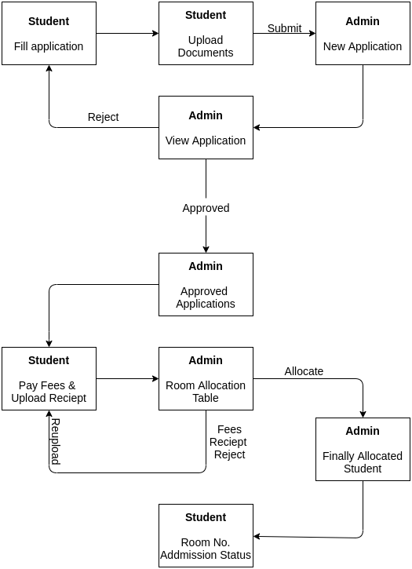
Admission Process

Slide 5
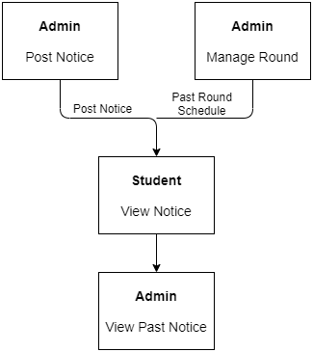
Notice

Slide 6
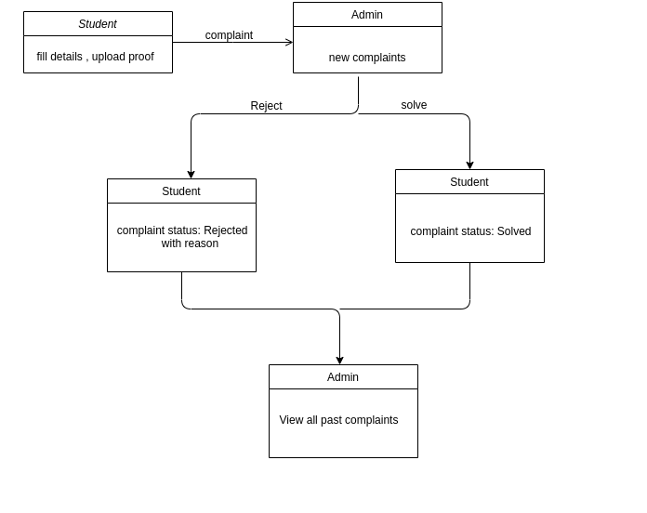
Complaint Diagram

Slide 7
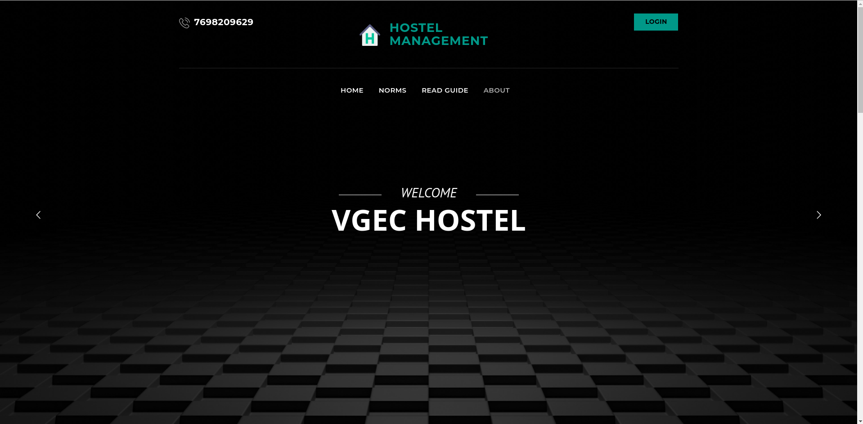
Home Page

Slide 8
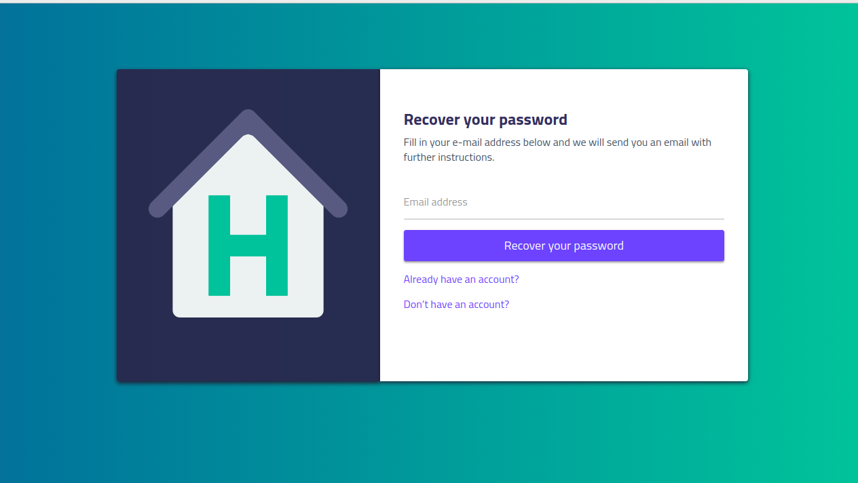
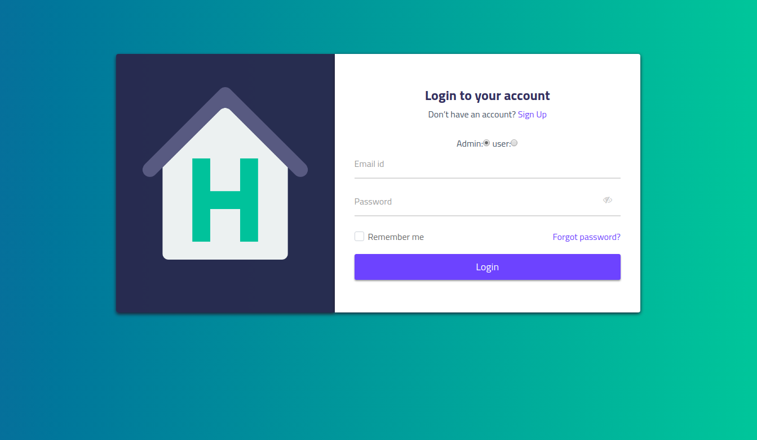
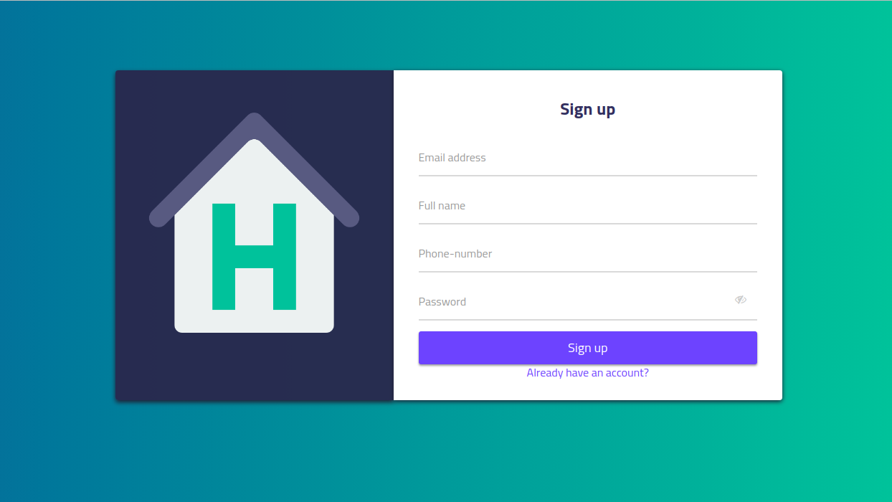
Forget Password
Log in
Sign up

Slide 9
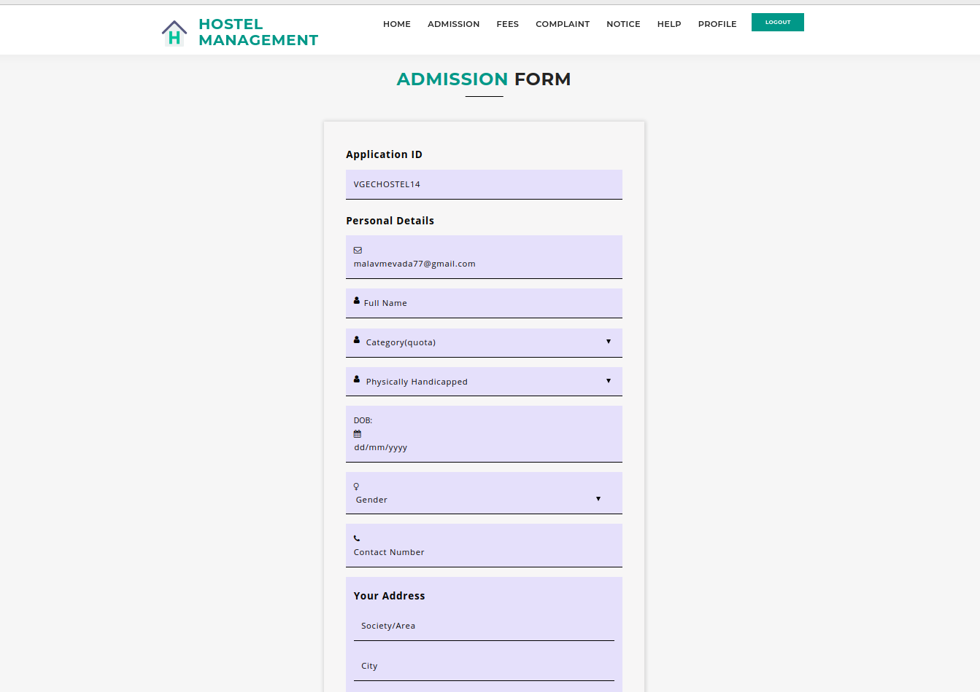
Admission Application

Slide 10
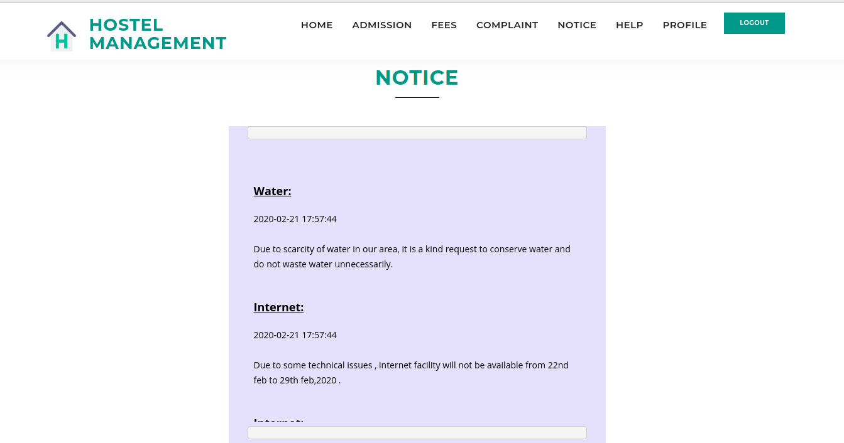
Notice

Slide 11
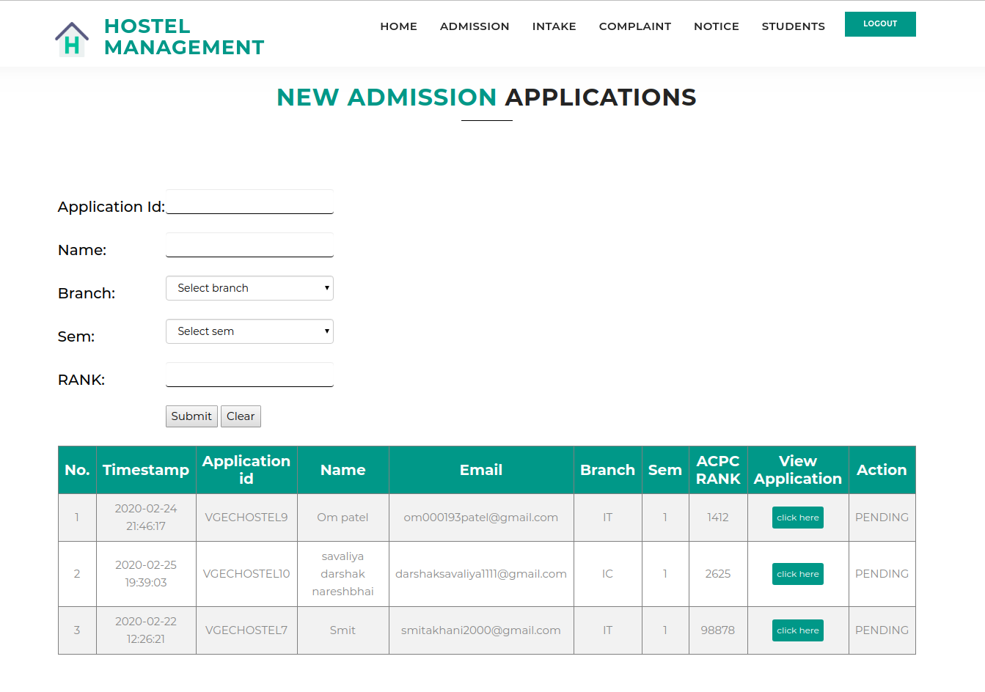
New Application that should be approved by Admin.

Slide 12
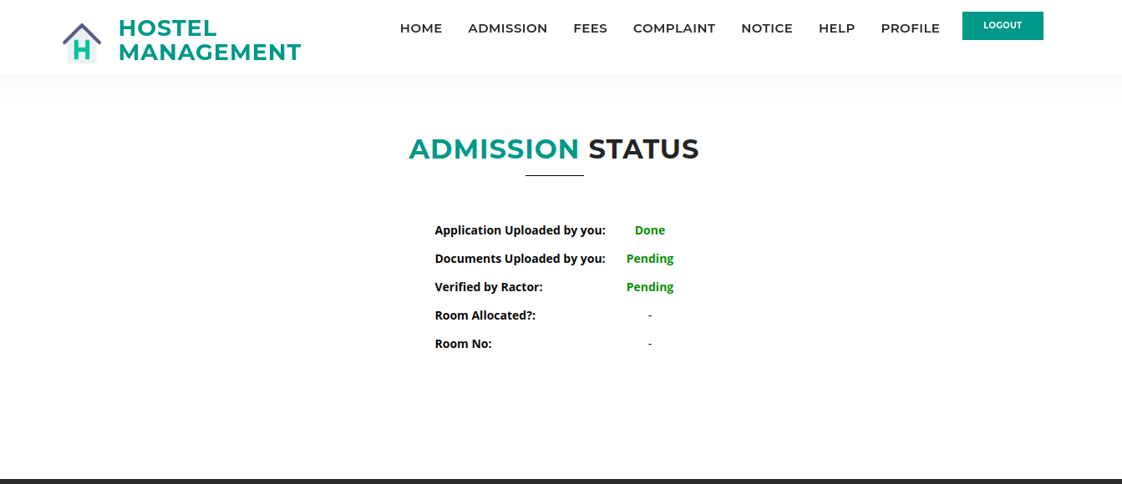
Admission Application status that will be informed to the respective student.

Slide 13
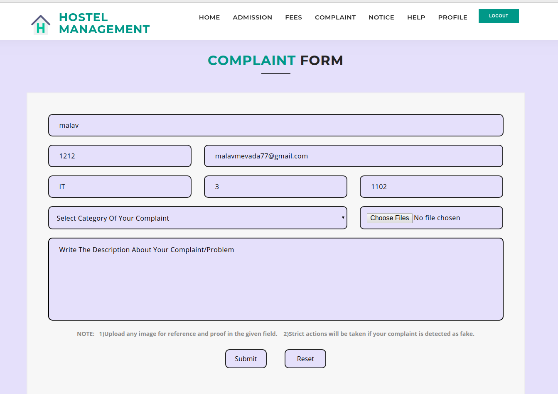
Complaint form will provide an easy interface between student and admin & it will make further process faster.

Slide 14
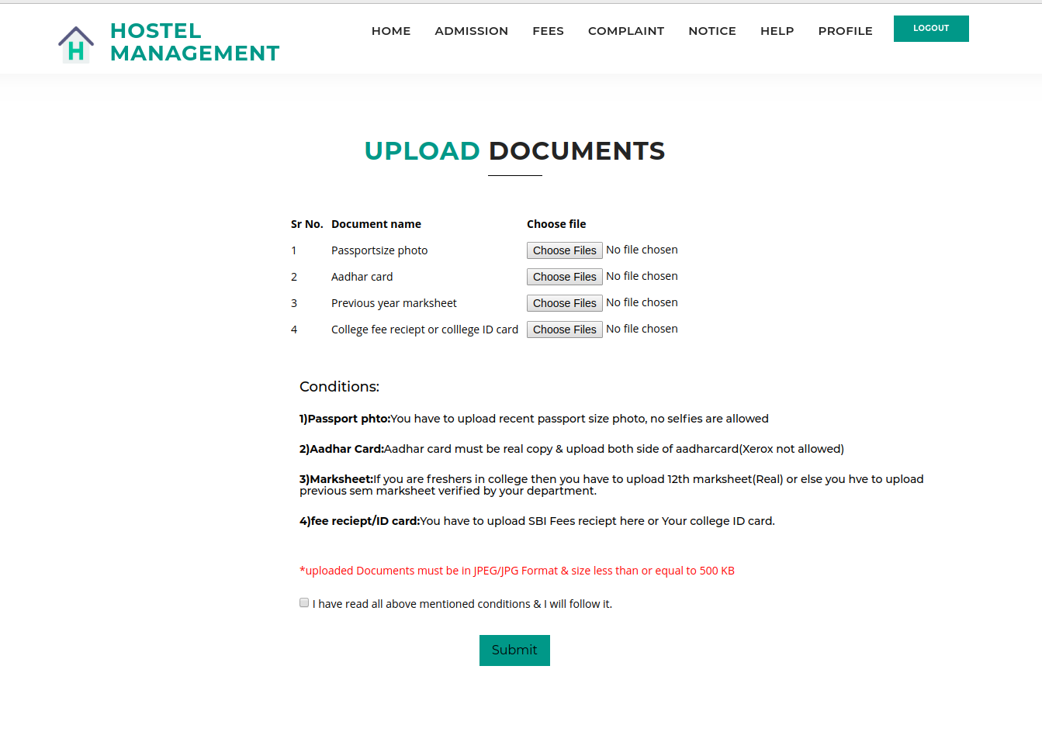
Upload Documents page will be provided to students to upload necessary documents for further process.

Slide 15
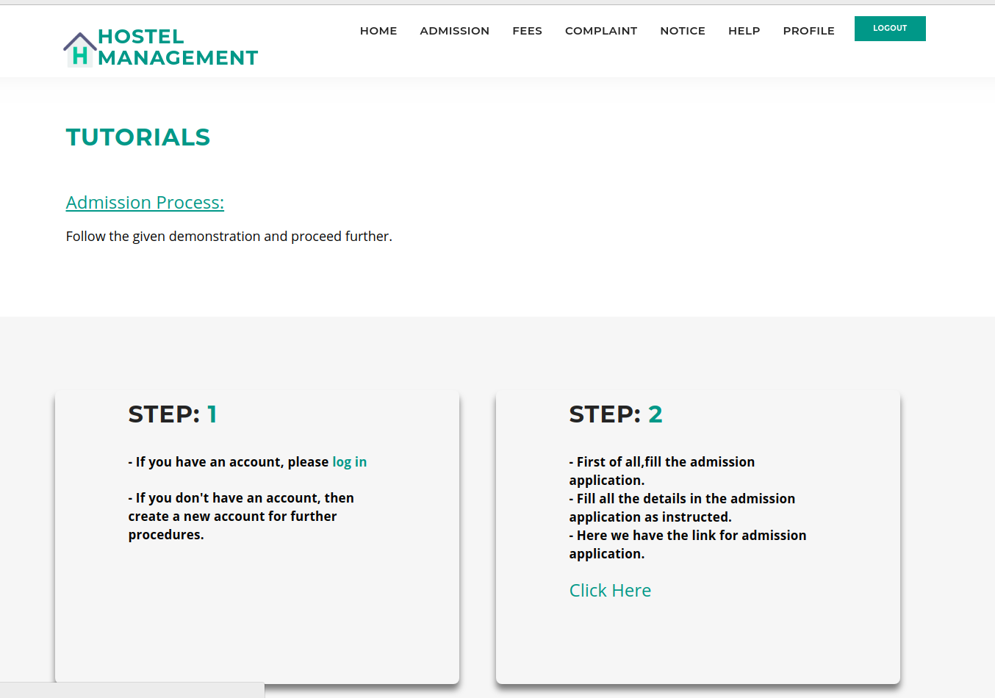
Read guide will be useful to know the website and will provide step wise tutorial for every process.

Slide 16
Thank You

